Slide 1

Phase-II Defining Research Questions Detecting Covid-19 in Chest X-Rays
Guided by: Dr. Sabah Mohammed
Mohan Prasad Kutala
mkutala@lakeheadu.ca

Slide 2
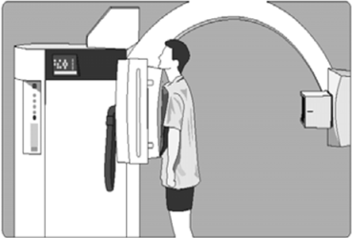

RQ 1:
Removing or adding noisy data
→ The patient’s anatomy has created variations in the X-ray intensity that the imaging system uses to create the image. But overlaying this image “signal” is the inherent statistical “noise” associated with the X-ray production process.
→ In an chest X-ray test where only a small amount of radiation has been used to create the image (low exposure), the distracting visual appearance of the statistical noise (sometimes known as “salt and pepper” noise)
Left Image referred from : http://imagingpathways.health.wa.gov.au/index.php/consumer-info/imaging-procedures/chest-x-ray
Right Image referred from : https://www.imageeprocessing.com/2011/10/add-salt-and-pepper-noise-to-image.html

Slide 3
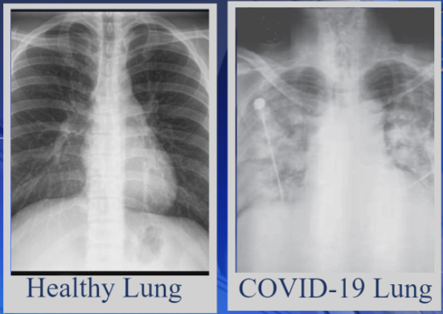
RQ 2:
Detecting COVID-19 severity using chest X-rays
→ The disease is caused by severe acute respiratory syndrome coronavirus-2 (SARS-COV-2), leading to high morbidity and mortality worldwide.
Test and Results: The COVID-19 test is typically done on respiratory samples obtained by a nasopharyngeal swab. Results are generally available within hours based on the test type.
Radiology experts will have possibility to detect the COVID-19 virus using chest X-rays. For this detecting we have to analyse the negative chest X-rays along with normal or positive X-rays to identify whether the two lungs are effected or not.
Above Image referred from : https://www.wlox.com/2021/01/16/covid-patients-have-persistent-symptoms-weeks-or-months-after-diagnoses/

Slide 4
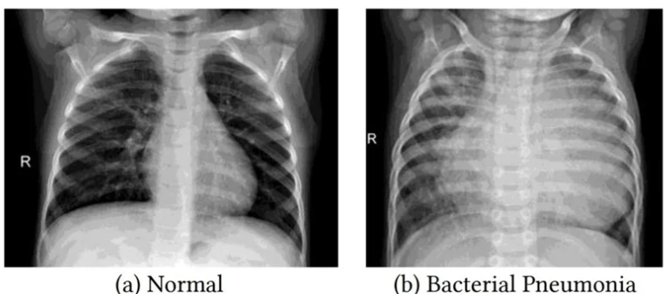
RQ 3:
Detecting Pneumonia using chest X-rays
Pneumonia is an infection that causes inflammation in one or both of the lungs. It can be caused by a virus, bacteria, fungi or other germs.
Doctor may conduct a physical exam and use chest x-ray, chest CT, chest ultrasound, or needle biopsy of the lung to help diagnose your condition.
When interpreting the x-ray, the radiologist will look for white spots in the lungs (called infiltrates) that identify an infection
Pneumonia can sometimes lead to serious complications, such as respiratory system failure, spread of infections, fluid surrounding the lungs, abscesses or uncontrolled inflammation throughout the body (sepsis).
Above Image referred from : https://www.news-medical.net/news/20201218/Transfer-learning-exploits-chest-Xray-to-diagnose-COVID-19-pneumonia.aspx

Slide 5
RQ 4:
Improving the efficiency of the training datasets
Over the last years, end-to-end trained convolutional neural networks (CNNs) have shown drastically superior performance
The use of deep learning on chest X-Rays has attracted some attention due to the cheapness of this imaging technique, the abundance of data and the similarity to natural images, which allows the transfer of models to medical tasks.
My approach I want to reduce the computational and memory requirement significantly, without sacrificing the classification performance.

Slide 6


